Slide 1
Application: Breast Cancer Risk Prediction
Gordon Gao
Carey Business School Professor

Slide 2
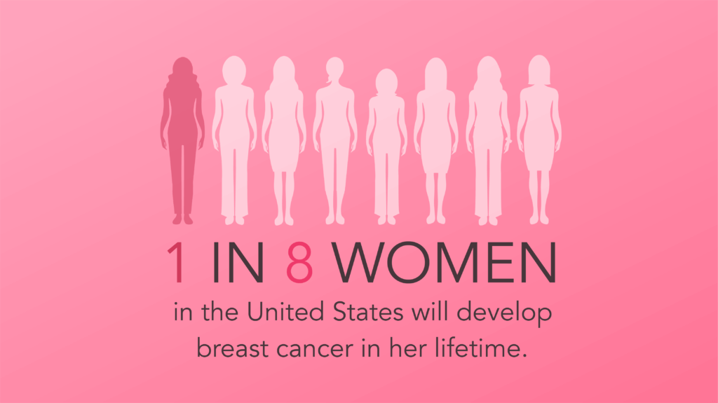

Slide 3
Every 2 minutes a woman is diagnosed with breast cancer in the United States.
In 2024, approximately 30% of all new female cancer diagnoses will be breast cancer.
Source:

Slide 4
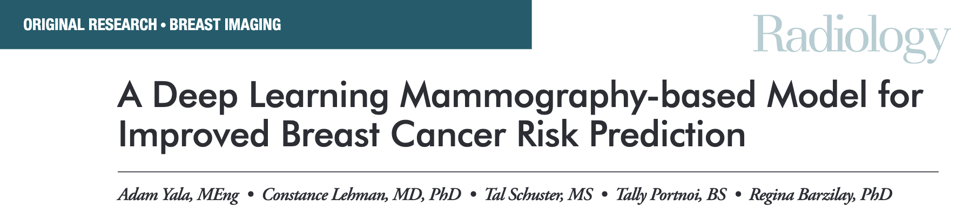
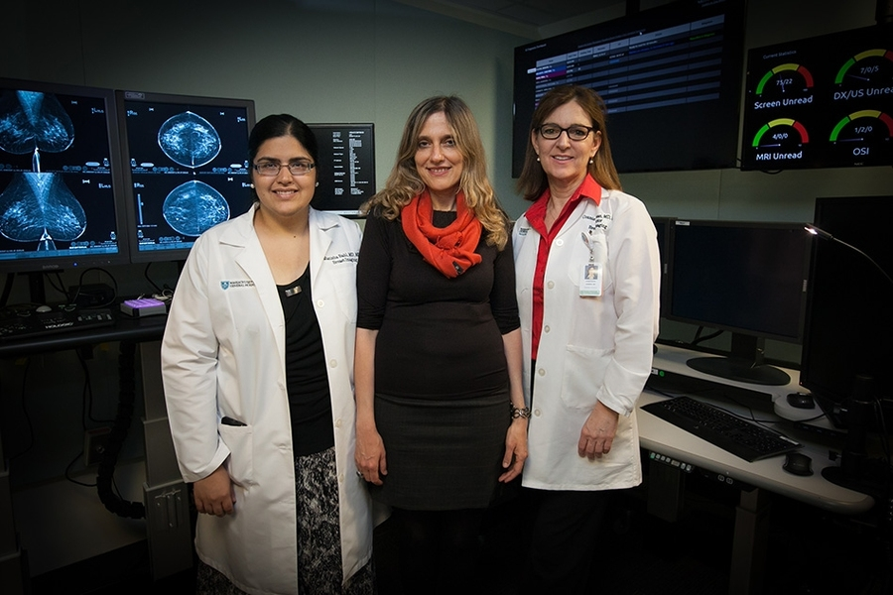
https://pubs.rsna.org/doi/epdf/10.1148/radiol.2019182716

Slide 5
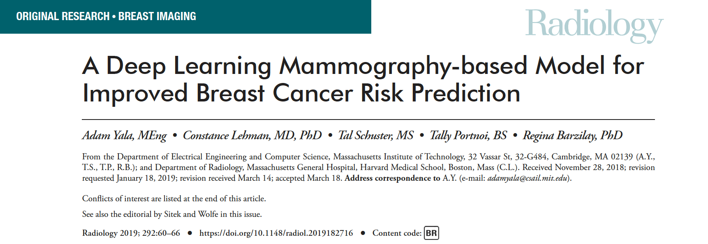
Try to read the original paper using NotebookLM
You can download the paper on Canvas Session 4

Slide 6
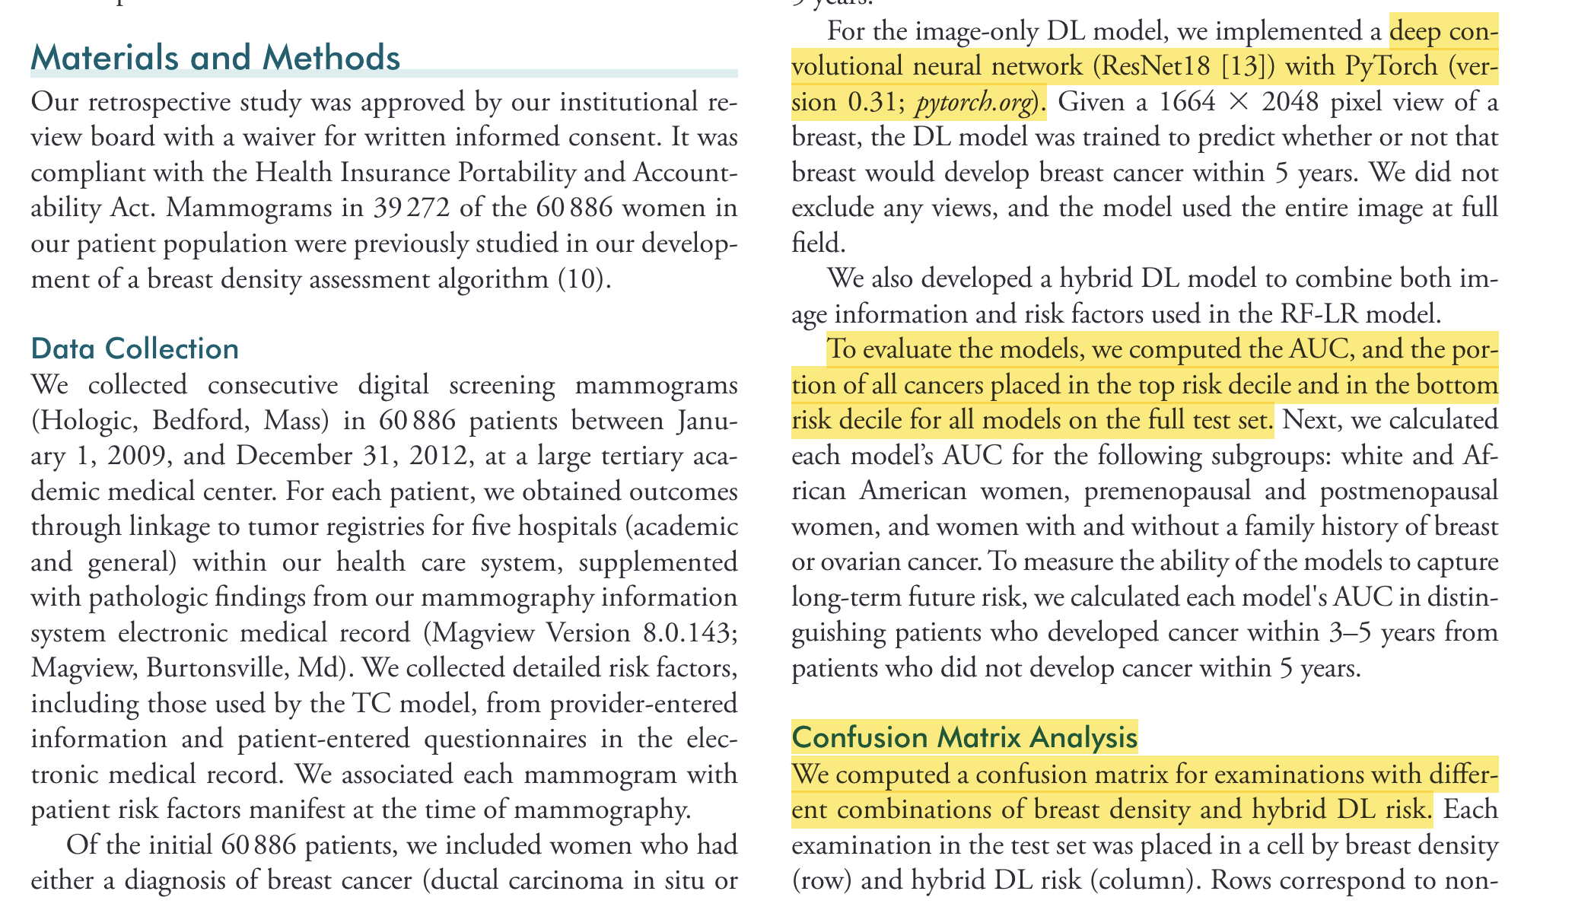
Radiology 2019; 292:60–66﻿ • https://doi.org/10.1148/radiol.2019182716

Slide 7
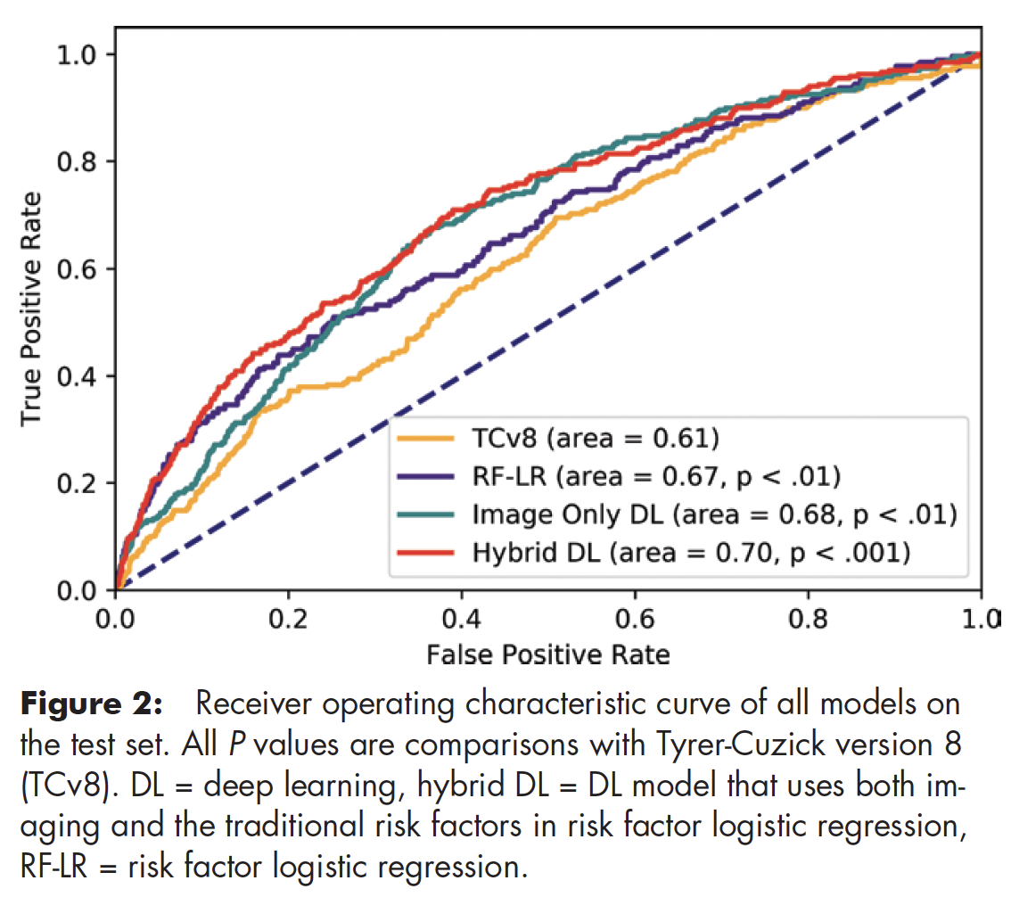

Slide 8
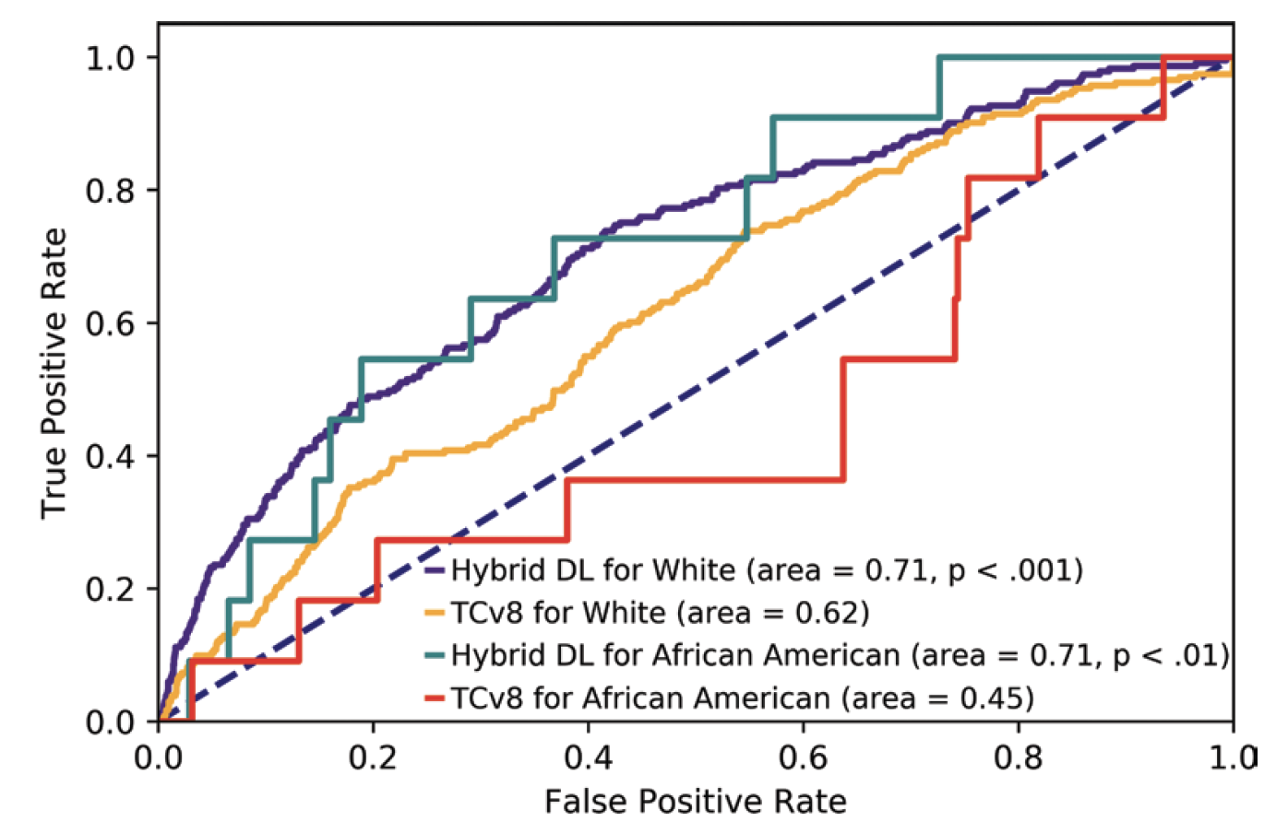

Slide 9
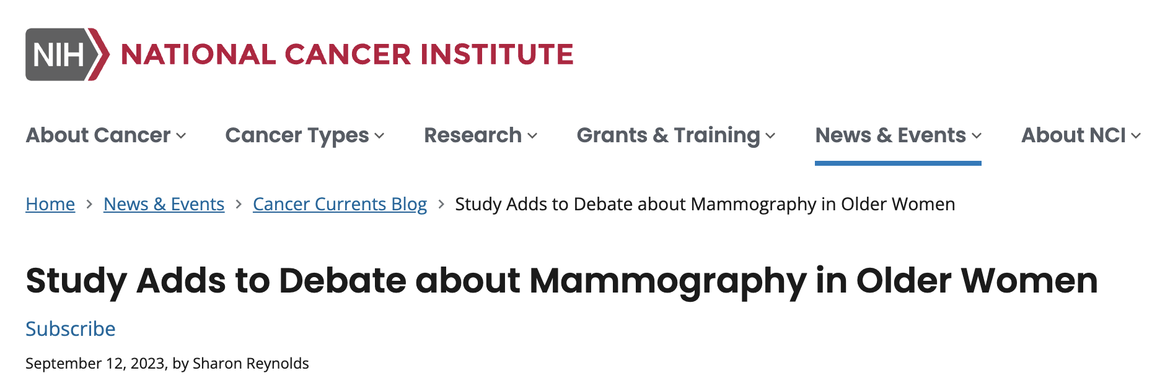
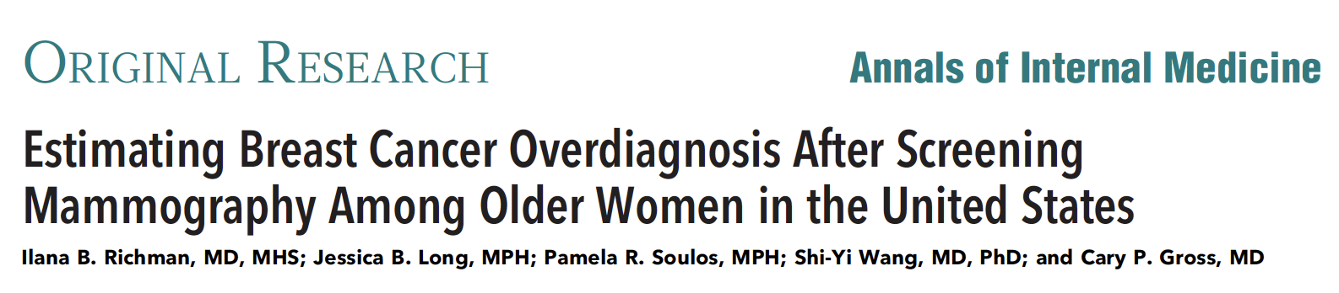
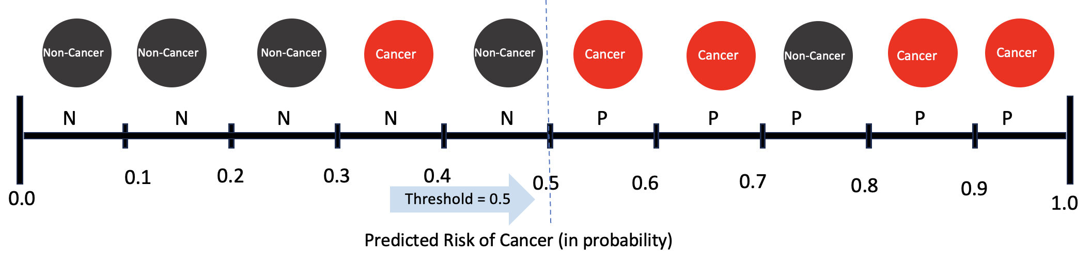
85 years and older: 54% of breast cancer may be overdiagnosed.
Up to 90% of women aged 80 years and older with nonmetastatic breast cancer undergo surgery
Where should you draw the line?
balance true positive and false positive

